Slide 1
온프레미스 위에 가상화 환경; VM + WEB/WAS + MYSQL
WEB
WAS
LB
mysql
WEB
WAS
온프레미스 + Vshpere

Slide 2
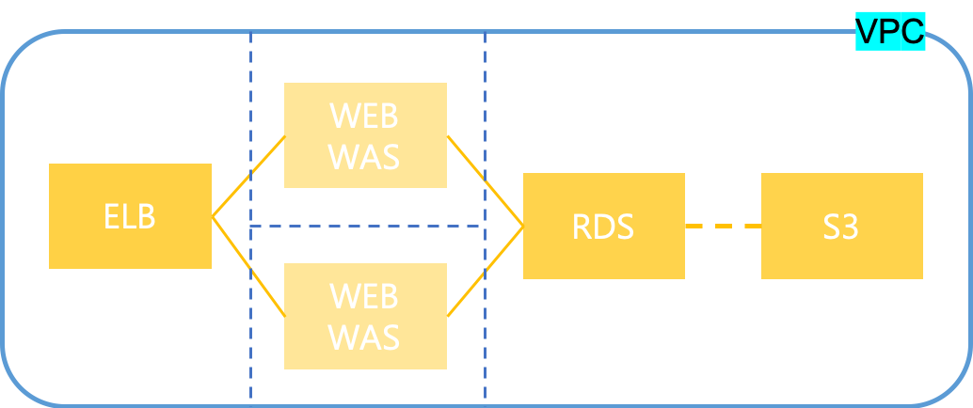
2. 퍼블릭 위에 가상화 환경 및 자동화 구현; AWS + WEB/WAS + RDS/S3 + Ansible
페이지A
VPC
WEB
WAS
ELB
RDS
S3
페이지B
ansible
WEB
WAS
AWS

Slide 3
3. 컨테이너를 통한 서비스 배포와 CI/CD; OPENSHIFT + WEB containerization + RDS/S3 + CI/CD
Service(LB)
Ingress controller
/페이지A
/페이지B
Service
Service
Deployment
Deployment
RDS
S3
Replicaset
Replicaset
pod
pod
pod
pod
Web
Web
RDS
S3
Web
Web
Was
Was
Was
Was
온프레미스 + OpenShift
AWS

